Slide 1
Files and I/O

Slide 2
Introduction
The java.io package, which provides support for I/O operations.
A stream can be defined as a sequence of data.
The InputStream is used to read data from a source.
The OutputStream is used for writing data to a destination.

Slide 3
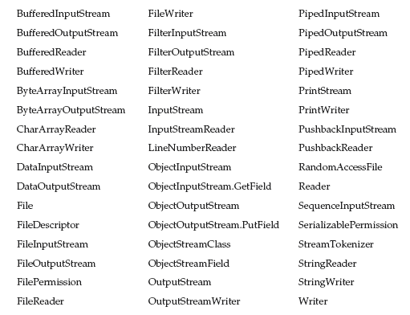
The Java I/O Classes

Slide 4

Interfaces

Slide 5
File
A File object is used to obtain or manipulate the information associated with a disk file, such as the permissions, time, date, and directory path, and to navigate subdirectory hierarchies.
Constructors
File(String directoryPath)
File(String directoryPath, String filename)
File(File dirObj, String filename)
File(URI uriObj)
FileInfo.java

Slide 6
Directories
A directory is a File that contains a list of other files and directories.
  isDirectory()
  String[ ] list()
DirList.java

Slide 7
Using FilenameFilter
To limit the number of files returned by the list( ) method to include only those files that match a certain filename pattern, or filter.
  String[ ] list(FilenameFilter FFObj)
FilenameFilter method
  boolean accept(File directory, String filename)
  DirListOnly.java

Slide 8
The listFiles( ) Alternative
Java 2 added listFiles():
File[ ] listFiles( )
File[ ] listFiles(FilenameFilter FFObj)
  Returns File array instead of string array, same as list
File[ ] listFiles(FileFilter FObj)
  returns those files with path names that satisfy the specified FileFilter.
  FileFilter method
    boolean accept(File path)
CreateDir.java
    Creating Directories

Slide 9
The Stream Classes
Java’s stream-based I/O is built upon four abstract classes: InputStream, OutputStream, Reader, and Writer.
InputStream and OutputStream are designed for byte streams.
  Byte streams are used to perform input and output of 8-bit bytes.
  E.g. works with bytes or other binary objects.
Reader and Writer are designed for character streams.
  Character streams are used to perform input and output for 16-bit unicode.
  Internally FileReader uses FileInputStream and FileWriter uses FileOutputStream.
  Reads and writes two bytes at a time.
  E.g. works with characters or strings.

Slide 10
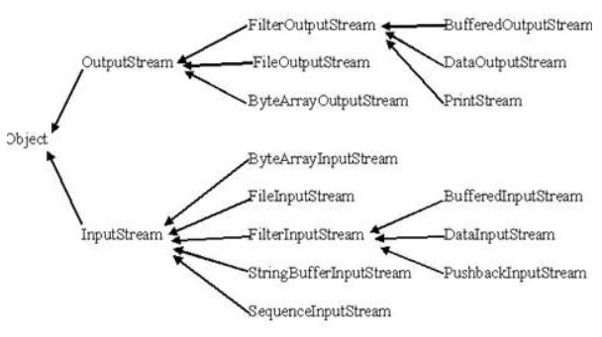
The Byte Streams

Slide 11
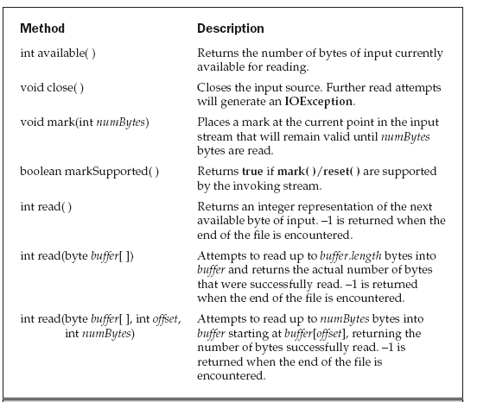
InputStream
All of the methods in this class will throw an IOException on error conditions.

Slide 12
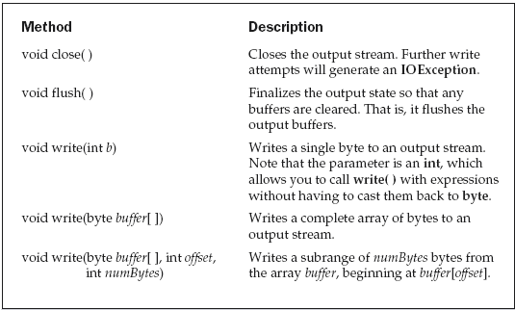
OutputStream

Slide 13
FileInputStream
The FileInputStream class creates an InputStream that you can use to read bytes from a file.
  FileInputStream(String filepath)
  FileInputStream(File fileObj)
    throw a FileNotFoundException
FileOutputStream creates an OutputStream that you can use to write bytes to a file.
  FileOutputStream(String filePath)
  FileOutputStream(File fileObj)
  FileOutputStream(String filePath, boolean append)
  FileOutputStream(File fileObj, boolean append)
    throw a FileNotFoundException or a SecurityException
  CopyFile.java
FileOutputStream

Slide 14
ByteArrayInputStream
Input stream that uses a byte array as the source.
  ByteArrayInputStream(byte array[ ])
  ByteArrayInputStream(byte array[ ], int start, int numBytes)
  ByteArrayInputStreamReset.java
An output stream that uses a byte array as the destination.
  ByteArrayOutputStream( )
  ByteArrayOutputStream(int numBytes)
  ByteArrayOutputStreamDemo.java
ByteArrayOutputStream

Slide 15
Filtered Byte Streams
Filter streams are also used to manipulate data reading from an underlying stream.
  FilterOutputStream(OutputStream os)
  FilterInputStream(InputStream is)
The methods provided in these classes are identical to those in InputStream and OutputStream.
It allows the user to make a chain using multiple input stream so that, the operations that are to be applied on this chain, may create a combine effects on several filters.
By using these streams, there is no need to convert the data from byte to char while writing to a file.

Slide 16
Buffered Byte Streams
A buffered stream extends a filtered stream class by attaching a memory buffer to the I/O streams.
This buffer allows Java to do I/O operations on more than a byte at a time, hence increasing performance.
The buffered byte stream classes are BufferedInputStream and BufferedOutputStream.

Slide 17
BufferedInputStream
Allows you to “wrap” any InputStream into a buffered stream and achieve performance improvement.
  BufferedInputStream(InputStream inputStream)
  BufferedInputStream(InputStream inputStream, int bufSize)
  BufferedInputStreamDemo.java
BufferedOutputStream(OutputStream outputStream)
  //buffer of 512 bytes
BufferedOutputStream(OutputStream outputStream, int bufSize)
BufferedOutputStream

Slide 18
DataInputStream
The Java.io.DataInputStream class lets an application read primitive Java data types from an underlying input stream in a machine-independent way.
  DataInputStream(InputStream in)
    FileInputDemo.java
  Similarly; DataOutputStream(OutputStream out)
The PrintStream class provides all of the formatting capabilities we have been using from the System file handle, System.out.
    FileOutputDemo.java
PrintStream

Slide 19
The Character Streams
Reader
  Reader is an abstract class that defines streaming character input.
  Throws IOException
Writer
  Writer is an abstract class that defines streaming character output.
  Throws IOException
FileReader
  The FileReader class creates a Reader that read the contents of a file.
  FileReader(String filePath)
  FileReader(File fileObj)
    throws FileNotFoundException

Slide 20
Con’t
FileWriter
  The FileWriter class creates a Writer that writes the contents to a file.
  FileWriter(String filePath)
  FileWriter(String filePath, boolean append)
  FileWriter(File fileObj)
  FileWriter(File fileObj, boolean append)
  CopyFile1.java
BufferedReader
BufferedReader improves performance by buffering input.
  BufferedReader(Reader inputStream)
  BufferedReader(Reader inputStream, int bufSize)
  FileRead.java

Slide 21
Con’t
BufferedWriter
BufferedWriter(Writer outputStream)
BufferedWriter(Writer outputStream, int bufSize)
  FileWriter1.java

Slide 22
StreamTokenizer
wc( ) Using a StreamTokenizer
WordCount.java
StringTokenizing.java
StringTokenizer

Slide 23
ZipOutputStream
ZipOutputStream(OutputStream out)
close()
  closes the ZIP output stream as well as the stream being filtered.
void closeEntry()
  closes the current ZIP entry and positions the stream for writing the next entry.
void finish()
  Finishes writing the contents of the ZIP output stream without closing the underlying stream.
void putNextEntry(ZipEntry e)
  Begins writing a new ZIP file entry and positions the stream to the start of the entry data.
void setComment(String comment)
  Sets the ZIP file comment.

Slide 24
Con’t
void setLevel(int level)
  Sets the compression level for subsequent entries which are DEFLATED.
void setMethod(int method)
  Sets the default compression method for subsequent entries.
void write(byte[] b, int off, int len)
  Writes an array of bytes to the current ZIP entry data.
  testZip.java

Slide 25
What is jar files? How to create it?
JAR : It is a java archive files used to package classes, files etc. as single file.
  This is similar to zip file in windows.
To create a jar file with all class files under the current directory.
  jar –cvf jarfilename.jar *.class
  c - to create a JAR file.
  f - the output goes to a file rather than to stdout.
  v -Produces verbose output on stdout while the JAR file is being built.
    The verbose output tells you the name of each file as it's added to the JAR file.
Can jar code be retrieved from byte code?
  Yes, class files can be decompiled using utilities like JAD(JAva Decompiler). This takes the class files as an input and generates a java file.

Slide 26
Serialization
Java provides a mechanism, called object serialization where an object can be represented as a sequence of bytes that includes the object's data as well as information about the object's type and the types of data stored in the object.
After a serialized object has been written into a file, it can be read from the file and deserialized that is, the type information and bytes that represent the object and its data can be used to recreate the object in memory.
The entire process is JVM independent.
  An object can be serialized on one platform and deserialized on an entirely different platform.

Slide 27
Con’t
ObjectOutputStream
  public final void writeObject(Object x) throws IOException
ObjectInputStream
  public final Object readObject() throws IOException, ClassNotFoundException.
  Employee.java
For a class to be serialized successfully two conditions:
  The class must implement the java.io.Serializable interface.
  All of the fields in the class must be serializable. If a field is not serializable, it must be marked transient.

Slide 28
Con’t
Serializing an Object:
  SerializeDemo.java
Deserializing an Object:
  DeserializeDemo.java

